Slide 1
The Role of Service Oriented Architecture within an Enterprise Architecture
Presentation to The Enterprise Architecture Conference 2005
8-10 August 2005
Sydney,Australia
Chris Tham
Head of Architecture, Distribution
National Australia Bank

Slide 2
Agenda
What is a Service Oriented Architecture (SOA) and how does it relate to an overall Enterprise Architecture (EA)?
Is SOA one of many "patterns" for EA or is it the underpinning foundation for implementing an EA?
How would an organisation go about delivering an SOA as part of an EA?
This case study talks about the National's experience with EA and SOA and covers topics such as:
  Selling SOA to management
  Embedding SOA into the EA - challenges and opportunities
  Aligning SOA to business strategy and process re-engineering
  The role of BPM, EAI and Information Management technologies in supporting an SOA
  How pervasive does an SOA need to be before it becomes enterprise-wide?

Slide 3
Just what is “SOA” anyway?
“The best thing since sliced bread” – guaranteed to cure cancer, solve world hunger, and retire Third World debt
Something to do with SOAP and Web Services
What my vendor says will be supported in their “Next Generation” product
Yet another meaningless Three Letter Acronym, to be replaced by another fad in 3 years
It’s the same thing as (OOP, RPC, CORBA, CICS, …)
All of the above?

Slide 4
What is a “Service-Oriented Architecture”
According to Gartner, the term “service oriented architecture” was first coined in 1994 by Alexander Pasik (a Gartner analyst) as a synonym for “client/server architecture” (request-response model for interprocess communication)
The current usage of the term has been expanded to incorporate IT concepts such as:
  Distributed computing
  Web services
  Functional modularisation across applications
  Object orientation
Related terms include:
  Business process modelling and orchestration
  Composite applications
  Reusability
  Component Architecture
  Enterprise Service Bus
  Workflow
  Virtualisation
One working definition:
  A Service Oriented Architecture is an application architecture within which key business functions are implemented as re-useable services with well-defined, invocable, interfaces, which can be called in a defined sequence to form business processes.

Slide 5
SOA – industry definitions
SOA is an architectural style for building software applications that use services available in a network such as the web. It promotes loose coupling between software components so that they can be reused. Applications in SOA are built based on services. A service is an implementation of a well-defined business functionality, and such services can then be consumed by clients in different applications or business processes.
SOA allows for the reuse of existing assets where new services can be created from an existing IT infrastructure of systems. In other words, it enables businesses to leverage existing investments by allowing them to reuse existing applications, and promises interoperability between heterogeneous applications and technologies. SOA provides a level of flexibility that wasn't possible before in the sense that:
Services are software components with well-defined interfaces that are implementation-independent. An important aspect of SOA is the separation of the service interface (the what) from its implementation (the how). Such services are consumed by clients that are not concerned with how these services will execute their requests.
  Services are self-contained (perform predetermined tasks) and loosely coupled (for independence)
  Services can be dynamically discovered
  Composite services can be built from aggregates of other services
  Service-Oriented Architecture (SOA) and Web Services: The Road to Enterprise Application Integration (EAI)
  Sun Developer Network
  (http://java.sun.com/developer/technicalArticles/WebServices/soa/)
Service-oriented architecture represents a framework facilitating integration and interoperability of disparate systems. A service-oriented architecture consists of three key elements: a collection of services, a connection protocol by which these services can be accessed and can access each other, and a repository containing a
catalog of available services. The governing principle of service-oriented architecture states that applications implement a collection of business capabilities and each of these capabilities can in turn be implemented by services, specialized pieces of software that implement a single business capability. Standardization acts as the key to a successful service-oriented architecture; not only must all
services have the same structure in terms of the interface they present to the outside world, they must follow a standard protocol for advertising what they do and how they can be accessed and used.
  Service-Oriented Architecture: Theory and Practice
  CORPORATE EXECUTIVE BOARD
A style of design, deployment, and management of both applications and software infrastructure
in which:
  Applications are organized into business units of work (business services) that are (typically) network accessible.
  Service interface definitions are first-class development artifacts, receiving the same degree of design attention (and more) as databases and applications.2
  Quality of service (QoS) characteristics (security, transactions, performance, style of service interaction, etc.) are explicitly identified and specified for each service.
  Software infrastructure takes active responsibility for managing service access, execution, and QoS.
  Services and their metadata are cataloged in a repository and discoverable by development tools and management tools.
  Protocols and structures within the architecture are predominantly, but not exclusively, based on industry standards (such as the emerging stack of standards around SOAP).
  Your Strategic SOA Platform Vision
  Randy Heffner
  Forrester
"SOA is a component model that inter-relates the different functional units of an application, called services, through well-defined interfaces and contracts between these services". Defined as such, SOA is a collection of patterns for building an enterprise-level integration layer between applications while abstracting those applications as services. SOA approach advocates the use of open standards, while not ruling out proprietary technologies where they are appropriate, when integrating applications.
SOA relies on exposing application functions as services that can be invoked by external parties. The commonly agreed aspects of the definition of a service in SOA are:
  Services are defined by explicit, implementation-independent interfaces.
  Services are loosely bound and invoked through communication protocols that stress location transparency and interoperability.
  Services encapsulate reusable business function.
  Develop a migration strategy from a legacy enterprise IT infrastructure to an SOA-based enterprise architecture
  Artem Papkov (artem@us.ibm.com)
  (http://www-128.ibm.com/developerworks/webservices/library/ws-migrate2soa/)

Slide 6
What is SOA in relation to an overall Enterprise Architecture?
Enterprise Architecture Definitions
ANSI/IEEE Std 1471-2000 definition of architecture:
  “the fundamental organization of a system, embodied in its components, their relationships to each other and the environment, and the principles governing its design and evolution”.
Architecture description:
  a formal description of an information system, organized in a way that supports reasoning about the structural properties of the system. It defines the components or building blocks that make up the overall information system, and provides a plan from which products can be procured, and systems developed, that will work together to implement the overall system. It thus enables you to manage your overall IT investment in a way that meets the needs of your business.
Architecture framework:
  a tool which can be used for developing a broad range of different architectures. It should describe a method for designing an information system in terms of a set of building blocks, and for showing how the building blocks fit together. It should contain a set of tools and provide a common vocabulary. It should also include a list of recommended standards and compliant products that can be used to implement the building blocks.
Business (or business process) architecture
  this defines the business strategy, governance, organisation, and key business processes.
Application architecture
  this kind of architecture provides a blueprint for the individual application systems to be deployed, their interactions, and their relationships to the core business processes of the organization.
Information/data architecture
  this describes the structure of an organization's logical and physical data assets and data management resources.
Technology/Infrastructure architecture
  this describes the software infrastructure intended to support the deployment of core, mission-critical applications. This type of software is sometimes referred to as "middleware".
Service Oriented Architecture?
Definitions taken from TOGAF Version 8

Slide 7
Degrees of Service Orientation
Services Oriented Organisation
  Entire organisation modelled as a set of services, and roles and responsibilities aligned to
Services Oriented Business Unit/Process
Services Oriented IT
  Every IT function defined as a service
Services Oriented Architecture
Services Oriented Project
Services Oriented Application
Services Oriented Infrastructure

Slide 8
Case Study of adoption of SOA within MLC
2002 IT Strategy and Enterprise Medium Term Vision led to the initiation the Amazon program.
  Established a Strategic Architecture Forum to review and approve major architecture decisions
Made a number of significant architecture investments that were fortuitously aligned to SOA
  Enterprise Business Functions
  J2EE Application Development Framework
  Secure Application Development Guidelines
  Logical Data Model
  Enterprise Security Framework
A set of “happy accidents” took us on the road to SOA:
  The need for J2EE/.NET interoperability led us to consider the use of Web Services (in particular SOAP and WSDL)
  The need to expose legacy functionality to front end applications led us to consider integration tools that are based on Web Services
  The need to create a unified servicing desktop led us to consider the use of portal frameworks and composite applications
  The need to create a single view of customer and aggregate data across multiple back-end systems led us to consider XML, business process management/orchestration and an enterprise service bus.
  The adoption of SOA became more relevant when we realised our key vendors (IBM, Microsoft, Siebel, Oracle, SAP) were also on the journey of rearchitecting their products.

Slide 9
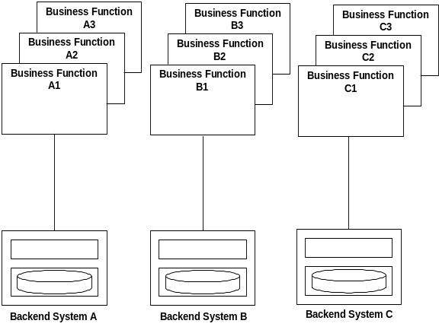
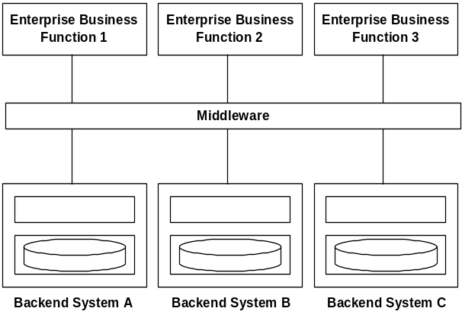
Example: Enterprise Business Function justification
- Typical Scenario without EBF’s-
- Typical Scenario With EBF’s -
Higher cost associated with maintaining distributed access to EBF’s
Minimal reusability across back-end systems
Multiple EBF’s accessing the same back-end systems - duplication of functionality (and associated effort/costs to develop)
Supports the delivery of reusable aggregated services to multiple channels
EBF’s can access a business rules engine to minimise development effort when business rules change
No need to maintain distributed EBF’s, e.g. located on Advisers PC.
Integrates with the EAI services

Slide 10
Example: Evolution of EBF one year later …
Current Scenario
Problem Description
Solution Approach
EBFs have been defined as the mechanism for implementing business services (as per WM architecture)
EBFs must rely on a number of common services to perform its functions. These include Use Interface, Integration, Security, Diagnostic services.
The Integration & Rule Services, User Interface and Security services are being defined as part of the Wave 2 architecture initiatives.
The EACV architecture approach is being finalized.
The current EBF Framework does not define implementation level details for integrating EBFs with these common services.
The architecture for interfacing Product EBFs and Customer / Adviser EBFs (EACV) must be defined.
The architecture for integrating EBFs with security services must be defined.
Enhance the EBF framework with re-useable design patterns that define the architectural approach for addressing common design / implementation scenarios.
Define the design patterns for integrating EBFs with each other, integration services, security services and monitoring services.
Define the common re-useable services to be implemented within the J2EE Application Development Framework (ADF) to support EBF implementation.
Login
Password
Login
Password
Login
Password
User
Interface
Login
Password
User
Interface
Login
Password
User
Interface
Login
Password
Channel Integration Services
Channel Integration Services
Product
EBF
EACV
EBF
Workflow
EBF
Business
Services
Product
EBF
EACV
EBF
Workflow
EBF
Security
EBF
Business
Services
Product
EBF
EACV
EBF
Workflow
EBF
Security
EBF
Business
Services
Application Integration Services
Application Integration Services
MasterKey+
EACV
Aggregated
Data
User &
Policy Dir.
Aggregated
Data
User &
Policy Dir.
Aggregated
Data
MasterKey+
EACV
MasterKey+
EACV
Data Integration Services
Data Integration Services
Compass
Gemini
Back-end Systems
Compass
Gemini
Back-end Systems
Compass
Gemini
Back-end Systems
MFND
CRMS
MFND
CRMS
MFND
CRMS

Slide 11
Lessons Learnt
Don’t start by describing the solution, start by articulating the problem
  Initially, we told the SAF we wanted to implement a “batch hub for EAI” – this was ultimately rejected as the business benefits were marginal
  In hindsight, if we had started by saying we had a “grand vision” and wanted to use Web Services, SAF would probably not have agreed either and raised concerns about the maturity of the concept
  We then adopted the approach of articulating what problem we were trying to solve (ie., “J2EE/.NET interoperability”, or “the best way to expose legacy functionality”)
Take management (ie. SAF) along on the journey
  We presented the SAF with various options for solving the above problems
  Regularly educate the SAF on key architecture concepts and industry trends
  We updated the SAF regularly with our progress, and the strength of our hypotheses
  We initiated Proof of Concepts to “road test” any new technologies
  By the time we presented our final recommendations, the SAF was comfortable on the feasibility of the solutions, and that risks have been appropriately mitigated
Take the broader organisation along on the journey
  Roadshows to IT staff
  Evangelisation to the business

Slide 12
Example: Articulating Architecture Issues that need resolving …
Current Architecture Issues Being Resolved…..
Potential Architecture items to review looking ahead…..
Review and recut the Infrastructure Design for Amazon given the changes in the Masterplan
Close out the Solution for foundation (i.e. Strategic ECV & EAV vs Tactical ECV & EAV)
Given the new technologies and frameworks involved determine how to progress an end-to-end proof of concept.
Finalise the LDAP solution (implementation and level of application security functionality)
Review security implication of confirmed designs & what we know of Wave 2 & learning's from vendor briefings - POC/Trust Model
Confirm HI & VI solution
Resolve iStrategy / Amazon overlap - Data/ETL
Enterprise Data Model, Data Administration and ongoing ownership
Determine the Strategic Reporting approach
Consider contingencies for Solution Architectures (e.g. If there is no selection of a tool from the RFP tender as it is too expensive to implement etc)
Clarify Bank alignment and IFS implications
Higher Priority Architecture Focus….
Interface Architecture - Review and confirm assumptions in design for all interfaces between components (Wave 1 & Wave 2)
Define Architecture Opportunities / Options - e.g. additional funding becomes available
Produce Architecture slides for a “Roadshow”
Other Architecture Tasks….
Much time has been spent so far on defining the Wave 1 Solution Architecture Hypotheses. Need to finalise the Wave 2 Solution Architecture Hypotheses (e.g. particularly for Enhanced Offer / Strategic Desktop).
Consolidate and report of information gained from vendor briefings and follow on meetings.
Produce a document outlining the advantages to the business of the architecture (i.e. incorporating Plug In Architecture document recently produced)
1
11
2
12
3
13
4
14
5
15
6
16
7
8
9
10

Slide 13
Example: Reporting Firmness of Solution Design Hypotheses
Project
Firmness of Solution
Design Hypotheses
Core Solutions Architecture Design
Hypotheses
Strategic Advice Platform
Shape
360 Workbench Enhancements
Consolidated Database
i2M
Operational View
AKM (Distribution Desktop)
ECV
Enhanced Offer
Flexiplan Project
Strategic Project
Masterkey Project
Desktop
Campaign Management (Marketing Desktop)
Call Centre/Admin
Project Andes
Buy new FPT and integrate into new HI/VI architecture
Enhance existing 360 Workbench
Enhance Masterkey
Enhance Masterkey
Siebel implementation
Siebel implementation
Enhance existing Flexiplan systems
Build within Compass and related satellite systems
Enhance existing Masterkey systems (Masterkey, MFND, Capsil)
Siebel implementation
Leverage existing call centre systems or Siebel - (Wave 2/3 project)
Trade up into Compass / Capsil - (Wave 2/3 project)
Not
Started
Significant
Analysis
Required
Some more
Analysis
Required
Strong
Hypothesis
Very Strong
Hypothesis
Project not in
Scope

Slide 14
Example: Presenting Options
Recommended Architectural solution
Options
1
Client DB
2
R/T Slave
3
Joint
4
Master
Assessment Criteria
Progression towards target (does it build towards the target architecture)
Level of throwaway/duplicated effort
Impact on users
Technical complexity
Delivery of a single source of truth
Risk - project and business
Time to market
Business benefits
Initial Cost
Ongoing Cost
Compliance/privacy
Flexibility
Resources
Life span of solution
Outcome based on current business view of phased implementation needs. Will result in multiple update sources for initial release. Transition to EACV being single point of update in subsequent release(s).
Best 4
Worst 0
Scale
Alignment with other projects/requirements (Enhanced Offer, Marketing, Con DB & Shape)
Slide <number>
32 28 37 47

Slide 15
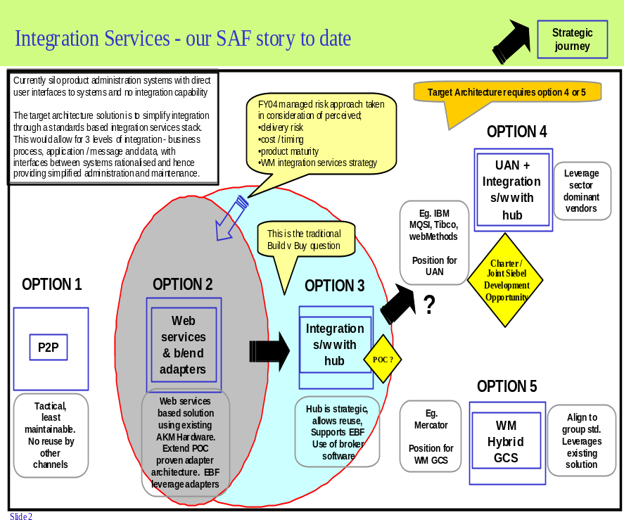

Example: Tradeoff between Strategic options and delivery risk
6 weeks ago we presented our EACV Strawman Solution Architecture to the SAF - our hypothesis position on Integration Services was that we would design, build and deploy a set of reusable in house developed web services and back end adapters leveraging the Servicing POC as appropriate
We also requested to undertake some more analysis where we could understand the requirement, and assess the relative merits of an integration services broker / hub software approach
High
Preferred Architecture
Trade offs
Delivery risks
Preferred Position
Low
High
Strategic alignment

Slide 16
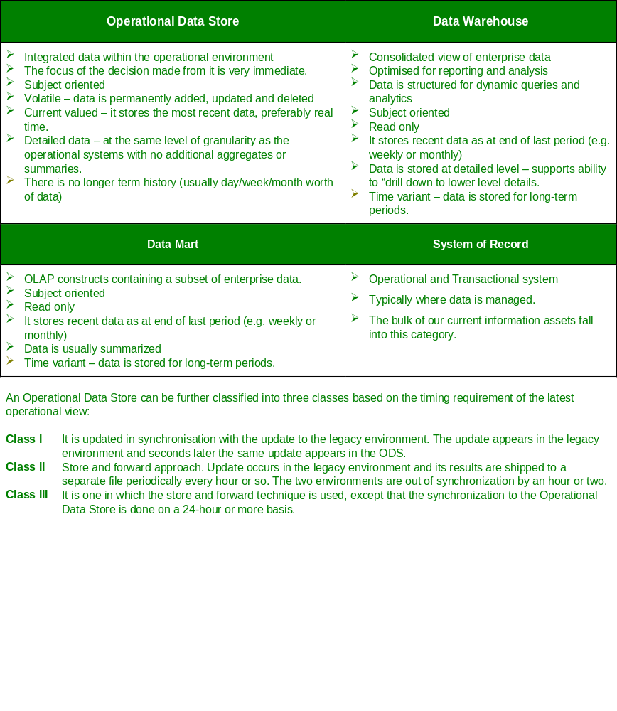
Example: Educating the SAF on Definitions

Slide 17
Example: Project Brief for the Proof of Concept for Strategic Desktop
Statement of Purpose:
Optimise the delivery of Servicing components across Amazon projects
Confirm and prove up the Amazon servicing solution hypotheses and target architecture
In Scope:
Access to Enquiry and switch transactions from Strategic Desktop to X and Y in real time
Overall Security Design
Servicing Components across the following Amazon projects:
  Enhanced Offer Servicing Components
  Strategic Desktop
  ECV
Out of Scope:
No other record systems besides X and Y will be accessed
Enterprise Middleware (EAI)
Siebel UAN capabilities
Product switching between admin systems
Product update transactions
Outcomes:
Confirmed understanding of business servicing requirements
Scope alignment between EO & Strategic Desktop
Schedule alignment between EO & Strategic Desktop
Recut project costs for EO and Strategic Desktop
Defined target servicing architecture that EO & Strategic Desktop will build to
Proof of concept built to verify target architecture:
  Ability to access back end record keeping systems in real time
  View, track and initiate workflow interactions
Key Hypotheses:
Business has defined the servicing requirements to a level of detail that will ensure that this project will not be delayed once initiated
It will be possible to re-use existing development environments to build and test the proof of concept
The start date of the project may be delayed to ensure the availability of the complete set of Asset team resources
An evaluation license can be obtained from IBM for installing MQ Serries and CICS connections on the mainframe
Major Project Risks:
Access to BAU resources to perform analysis (This has not yet been negotiated with ADM BAU)
Access to Asset development environments (This has not yet been negotiated with ADM BAU)
Access to Siebel expertise to do the front end display
Major Project Milestones:
Project Initiation 2 weeks
Design 4 weeks
Build 5 weeks
Test 2 weeks
Project Leadership:
PCG: XXX
Project Leader: YYY
Team members:
1 x Project Manager,Architect (0.5 SD & 0.5 EO), Siebel (1), MFND(1), Capsil(1), CRMS(1), Gemini(1) & MQ(0.5), IBM GSA $100K - configure Mainframe MQ
Initiative Costs
$ZZZ

Slide 18
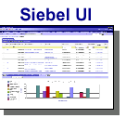
Example: Proposed Architecture for Proof of Concept
Security
Connectivity
Access to Back-end System
Screen Scraping or message based?
Effective deployment of MQ
Mainframe
MQ
CICS
Transaction
MFND
Siebel Server
MQ Server
Unix
Siebel Objects
Siebel Workflow
Siebel
Adapter
Siebel
MQ
Transport
Adapter
MQ
MQ
Websphere
CompassI
compass
Unix
MQ
Websphere
EBF?
CRMS
Workflow
Siebel EAI
Compass-I?
Reuse CRMS (back-end)?
Compass-I?
Reuse CRMS (back-end)?
Siebel
Database
Which components of Siebel Financial vertical to be used for POC?
How does Siebel Workflow interact with the existing CRMS workflow?
Which components of Siebel Financial vertical to eb used for POC?
How does Siebel Workflow interact with the existing CRMS workflow?
Unix
MQ
Websphere
EBF?
Tower
Imaging

Slide 19
Example: Outcomes of POC
POC has successfully demonstrated that a subset of technologies proposed for the integration servicing architecture can work as a whole in the Wealth Management environment.
POC has achieved all the technical objectives and adhered to the guiding principles on which the integration framework was based upon and successfully validated.
The actual effort spent on the development of integration was reduced as the degree of of complexity was lower than anticipated
In addition, POC has expanded the scope and successfully addressed the following additional requirements:
  Explore alternative way of accessing mainframe applications by using Siebel Portal Framework and HATS (Host Access Transaction Server) software
  Conduct architecture analysis on the integration of other work-flow applications (Gemini, Staffware and Kust) by applying the lesson learnt from the POC.
Proposed security design that would implement WMT security policy i.e. placing security as close to the data as possible, has been partially achieved. The token acquisition and validation have not been implemented as it would require system software changes on both AKM and CICS/DB2 environments. As there were no technical impediment in implementing the proposed approach, it was recommended that token acquisition and validation be progress as part of Amazon Wave 2 security.

Slide 20
Example: Key Issue uncovered as a result of running a POC
Client Memory Usage error
  It has come to light during performance testing phase of the POC that certain file downloads (between 5 and 10 megs) resulting in very high memory usage of around 350-400meg+ and this appears to be the combined result of the .Net code and the .net framework used for accessing web services.
  If this cannot be resolved each Client Machine (Dialup machine) would require an allocation of 1 GB (Minimum) of free hard disk space to process large files.
The POC team is currently investigating options in resolving this issue, including
  The memory usage could possible be reduced by restructuring the Client Code to not load the entire file into memory before processing.
  The memory usage within the .Net framework, however, is out of our control and could only be reduced by utilising a new architecture for the communication between VI Client and VI Coordinator; possibly dropping down a protocol level to HTTP or if absolutely necessary TCP Sockets. This would require endorsement by Architecture team)

Slide 21
Example: Lessons learnt from presenting to the SAF
Where SAF presentations have not gone smoothly
Lesson learnt/principle
Lack of content
Lack of buy-in
Mis-directed/incomplete syndication
Ineffective peer review
Not taking SAF along for the journey
Optionsand evaluation not clear
Not demonstrating that process has been followed
Not demonstrating that analysis has been done
Business drivers not agreed or understodd
Lack of context
Revisit last presentation (if applicable) and outline progress of previous issues/agreements and the current state of the project/program/activity
Position current presentation into the overall journey and clarify next steps. Explain the process you’re following.
Provide references to Group position, if applicable.
Detail what the implications of the decision being asked for would make for the project and for MLC.
Consider cost implications for BAU.
Relate the current activity/project/program to business strategy.
Report progress of any hypothesis previously presented.
Ensure that any syndication is relevant and specific.
Highlight any dependencies/overlaps with other projects.
Expect and prepare for a robust discussion at the SAF.
Don’t pack too much into any one presentation - break the story up into manageable chuncks - especially if subject is complex.
Don’t gloss over anything.

Slide 22

Example: Feedback from Roadshow …
The majority of feedback for the SHAPE roadshow in Perth, Melbourne and Sydney was positive
Questions 1-4 (total respondents in Perth, Melbourne & Sydney): Over 90% gained useful knowledge, viewed the session as worthwhile to attend, and indicated they would attend another similar Amazon information session.
What was the most interesting part of the session? Total respondents indicated that the focus on architecture (13%) and integration (12%) was the most interesting aspect of the session. (20% ‘no comment’)
Is there anything you would change about the session? Over 47% of total respondents did not comment/ indicated they would change nothing about the session, 19% indicated logistics
    Sydney respondents indicated the venue was too small, that they could not see slides from the back
    Perth respondents indicates that they would have liked more time for questions
    All respondents expressed a preference for a break in the middle of the session
Many respondents responded ‘no comment’ to many survey questions, indicative of the high quality of the presentation

Slide 23
The National’s adoption of SOA – Current Status
SOA principles and web services deployed in pockets within the organisation
  Most notably for a financial planning tool which exposes Web Services to third parties and J2EE/.NET integration.
A wider adoption of SOA within one business unit was put on hold due to organisational restructure.
  This would have involved the use of portal technology, composite applications, business process orchestration, and exposure of legacy system functionality as services to create an integrated servicing desktop.
However, BPM technologies currently being investigated, with potential application in three business areas.
  Potential to convert consumer lending fulfilment from bespoke functionality implemented on an obsolete platform to a workflow based implementation.
Some parts of the business are adopting process modelling disciplines, which may prepare the organization for wider adoption of SOA in the future.
  Drivers include faster product innovation and compliance (SOX, BASEL, IFRS)
A new Enterprise Architecture has been defined based on SOA principles and adoption of BPM and EAI technologies
  Fit for purpose front ends
  Converged and shared sales and servicing functions
  Product rules and features independent of core systems

